Slide 1
Encapsulation Update
Aleesha KT
CMU MAC Meeting, 16/ 9 / 2024

Slide 2
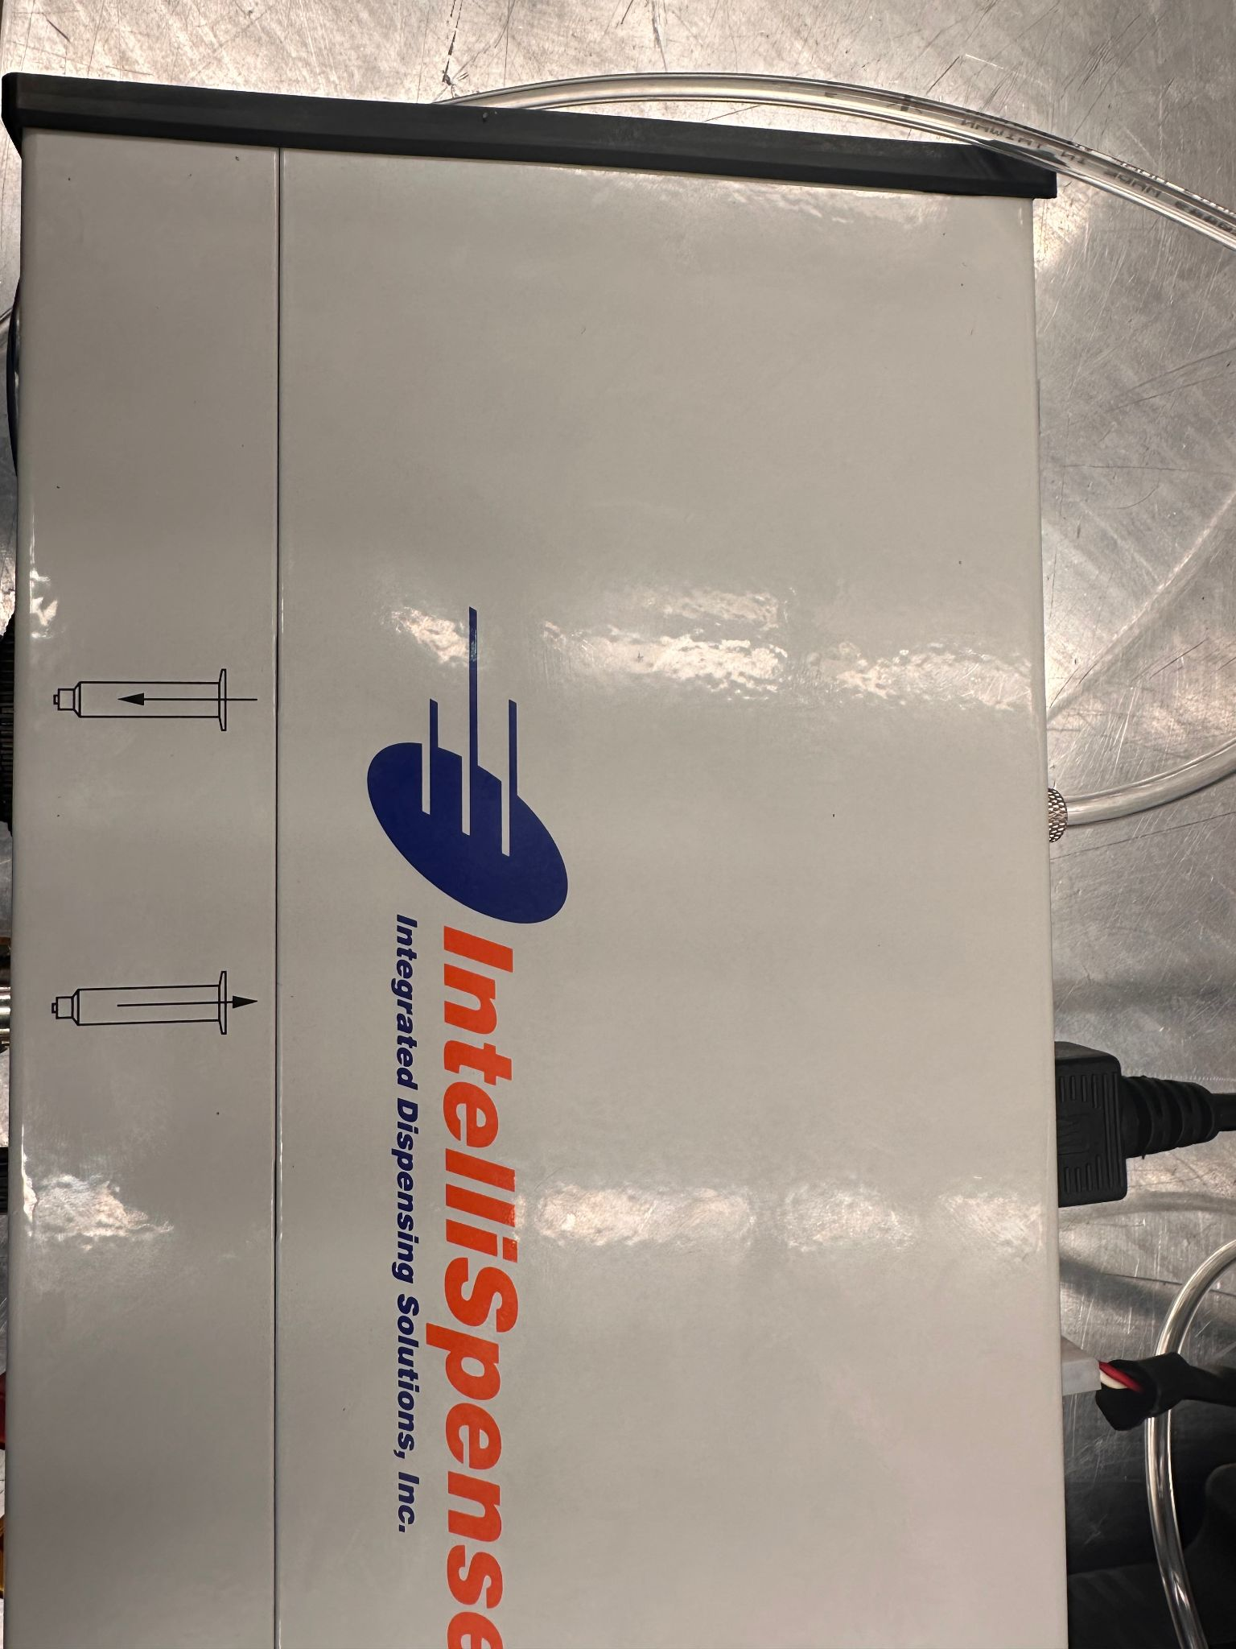
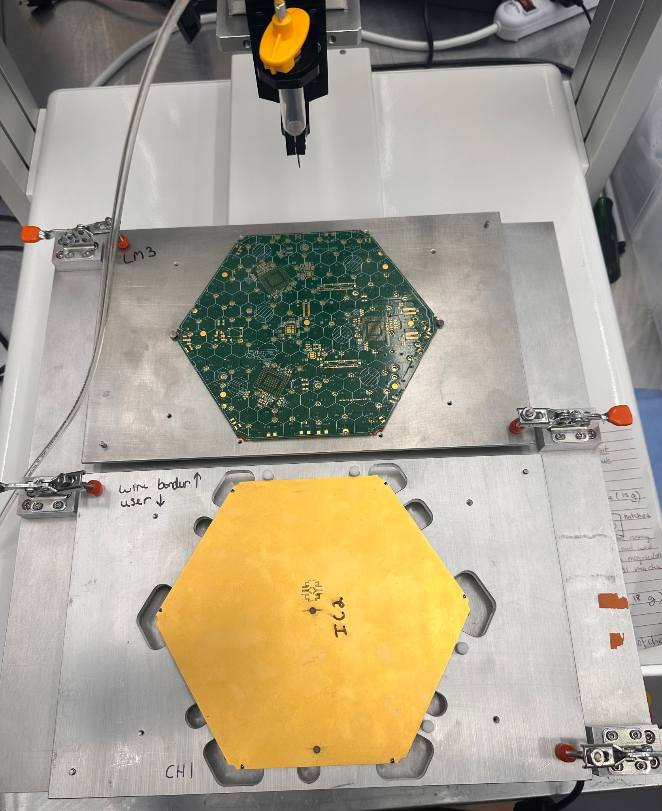
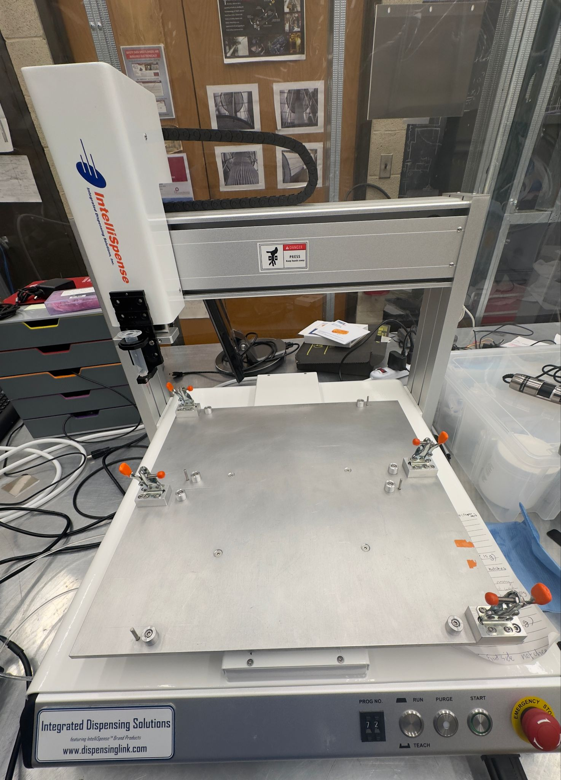
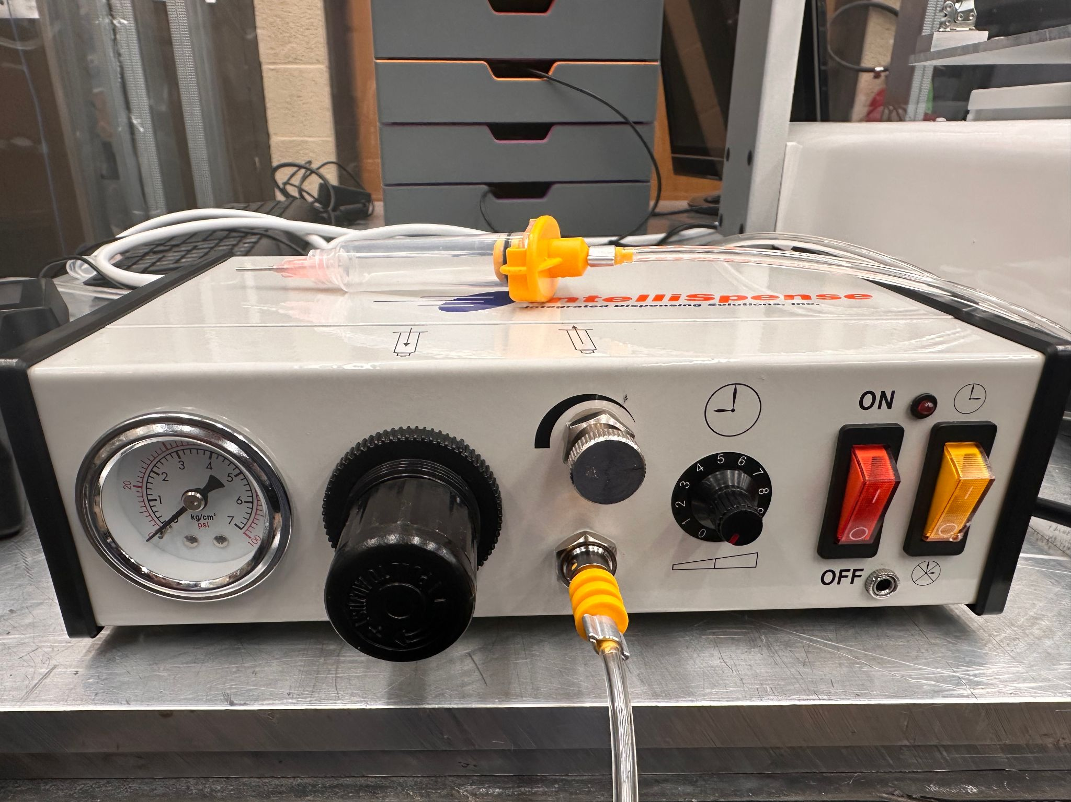
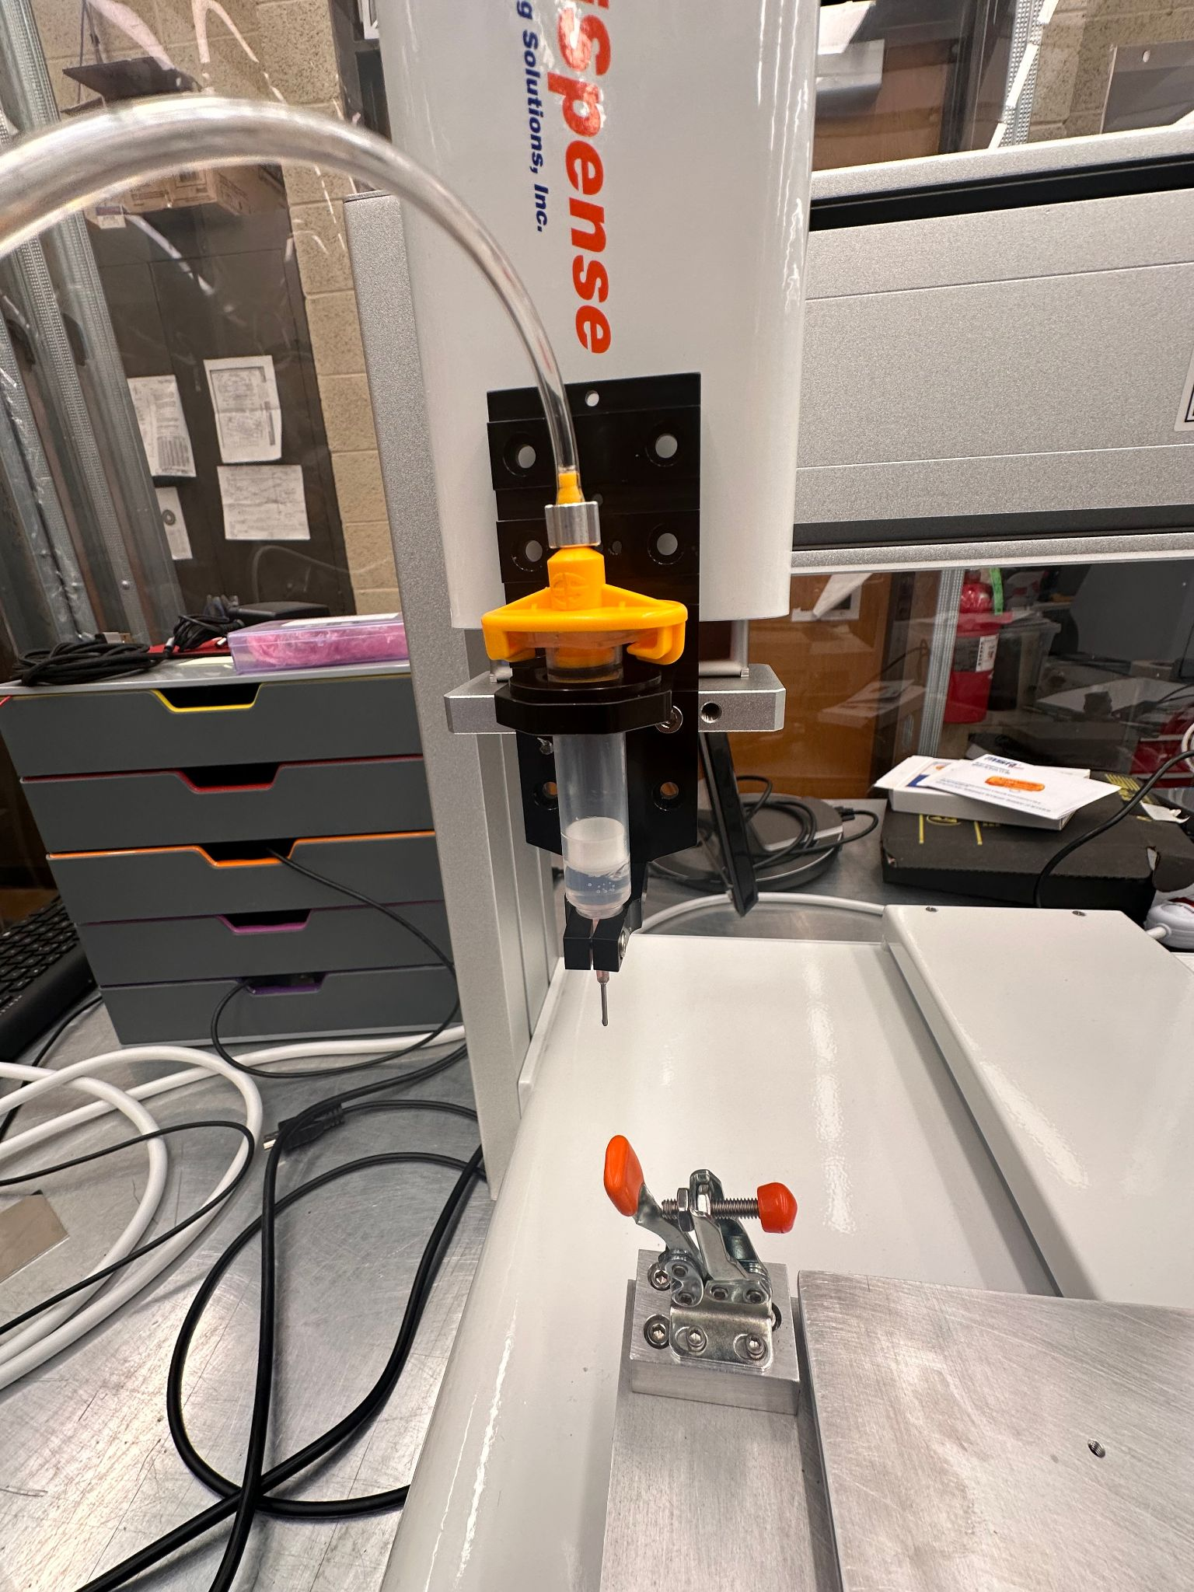
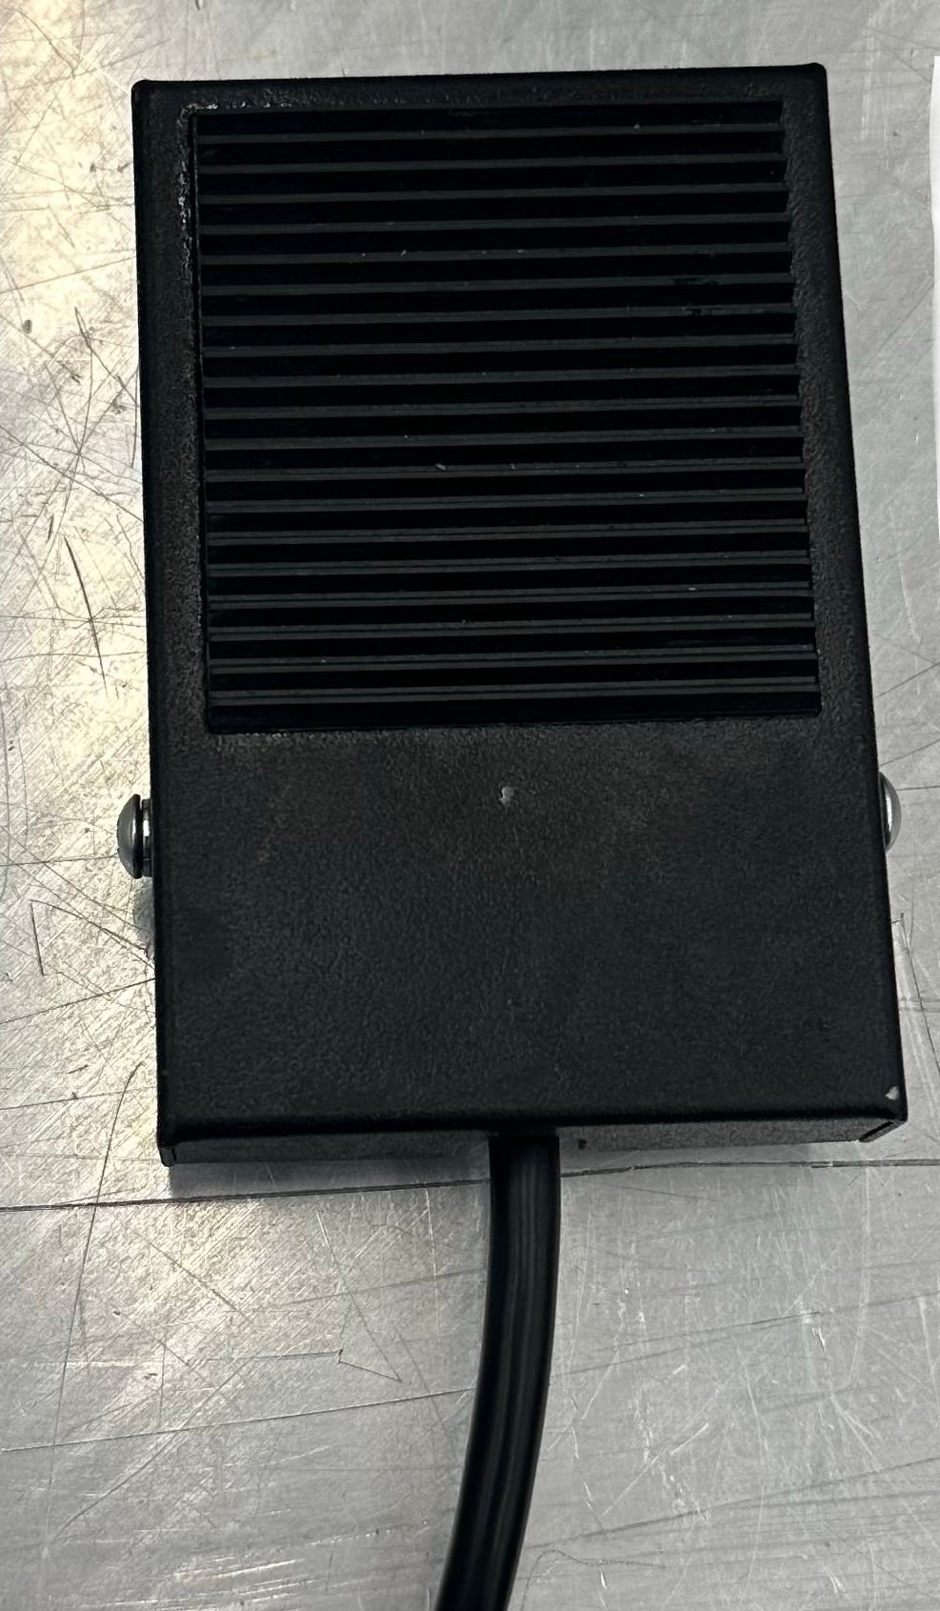
SETUP
MINI-GANTRY
DISPENSER
Vacuum knob
Pressure Regulator
FOOT PEDAL
Notes:
Take a pic of mini-gantry

Slide 3
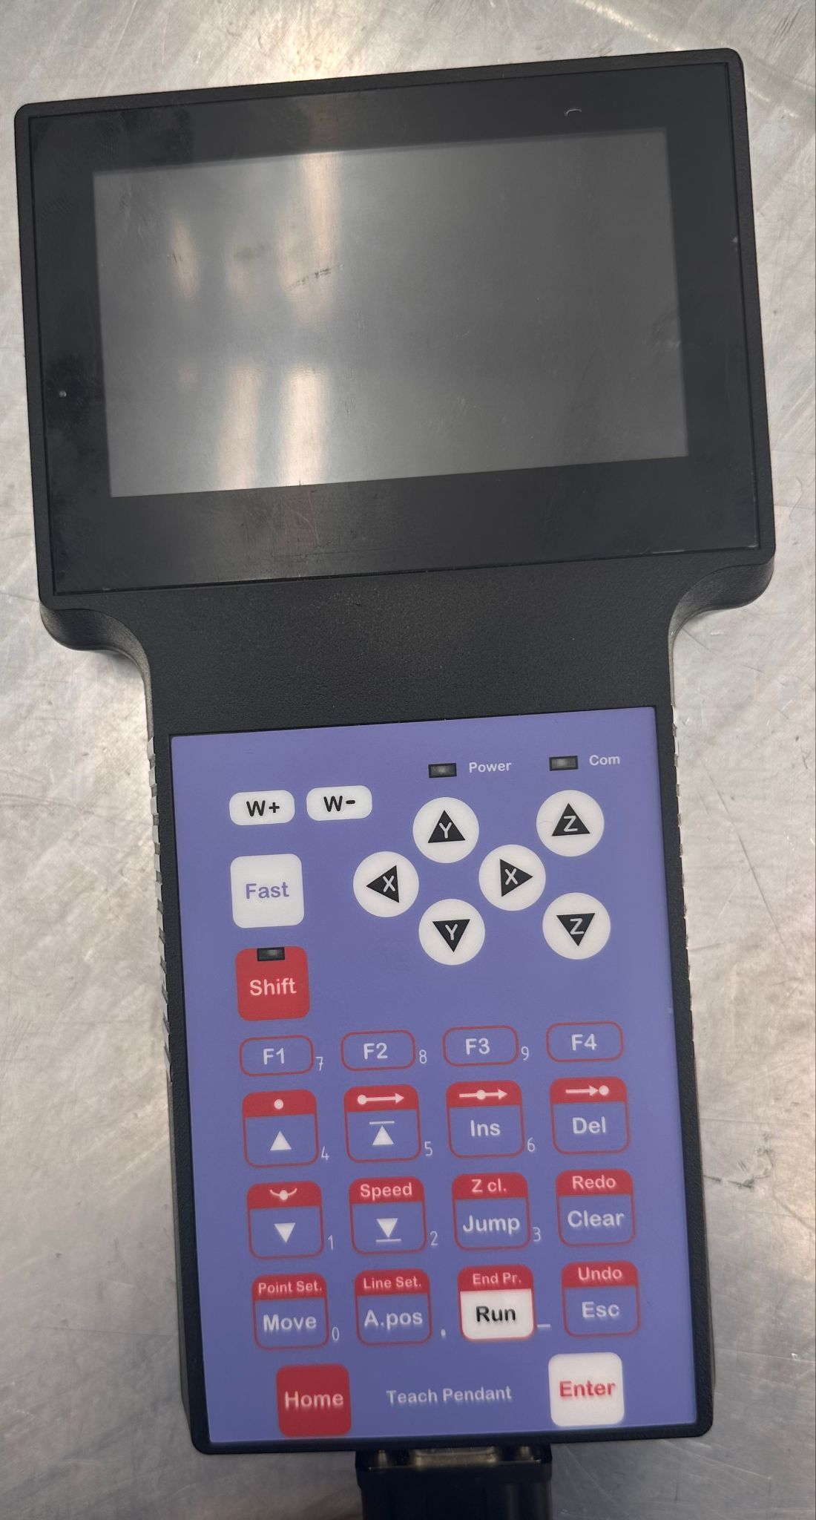
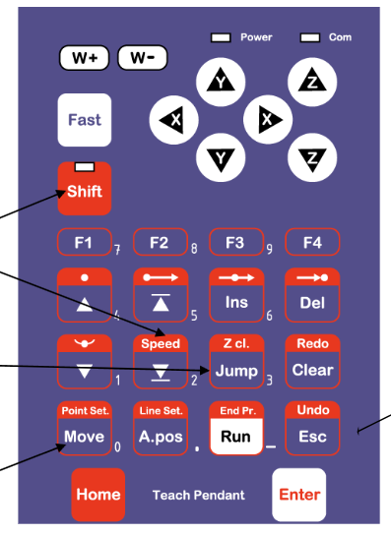
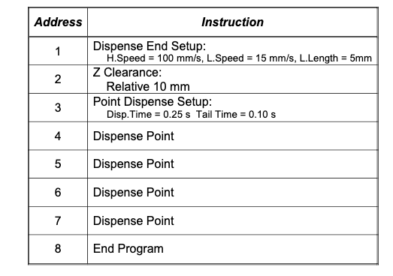
TEACH PENDANT/REMOTE
Program = series of instructions stored in the main memory unit
Each instruction is stored in a numbered MEMORY ADDRESS (MA)
X,Y,Z axis value
Dispensing time, Line speed

Slide 4
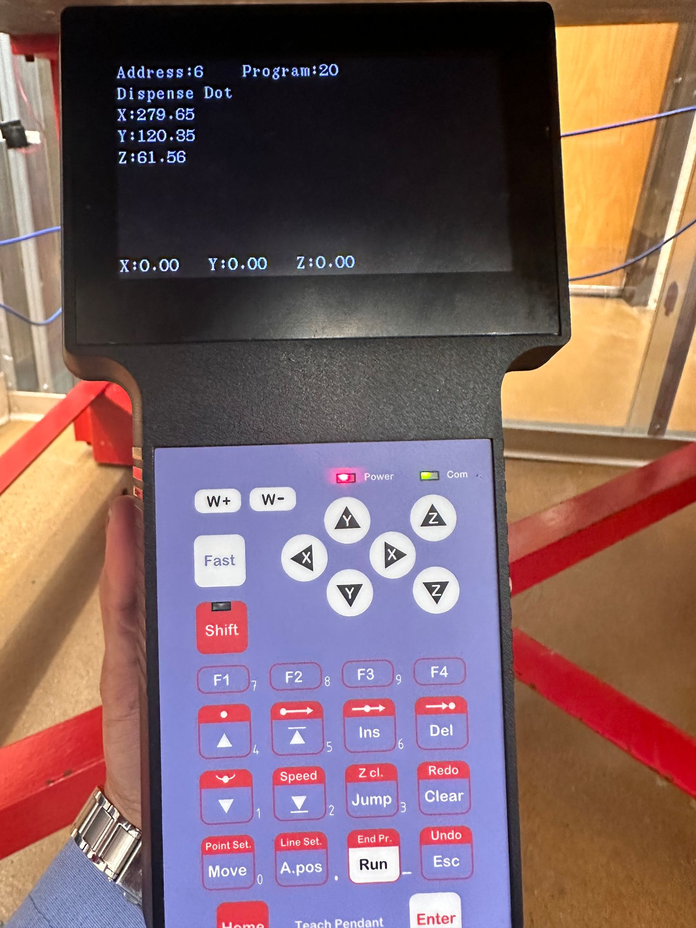
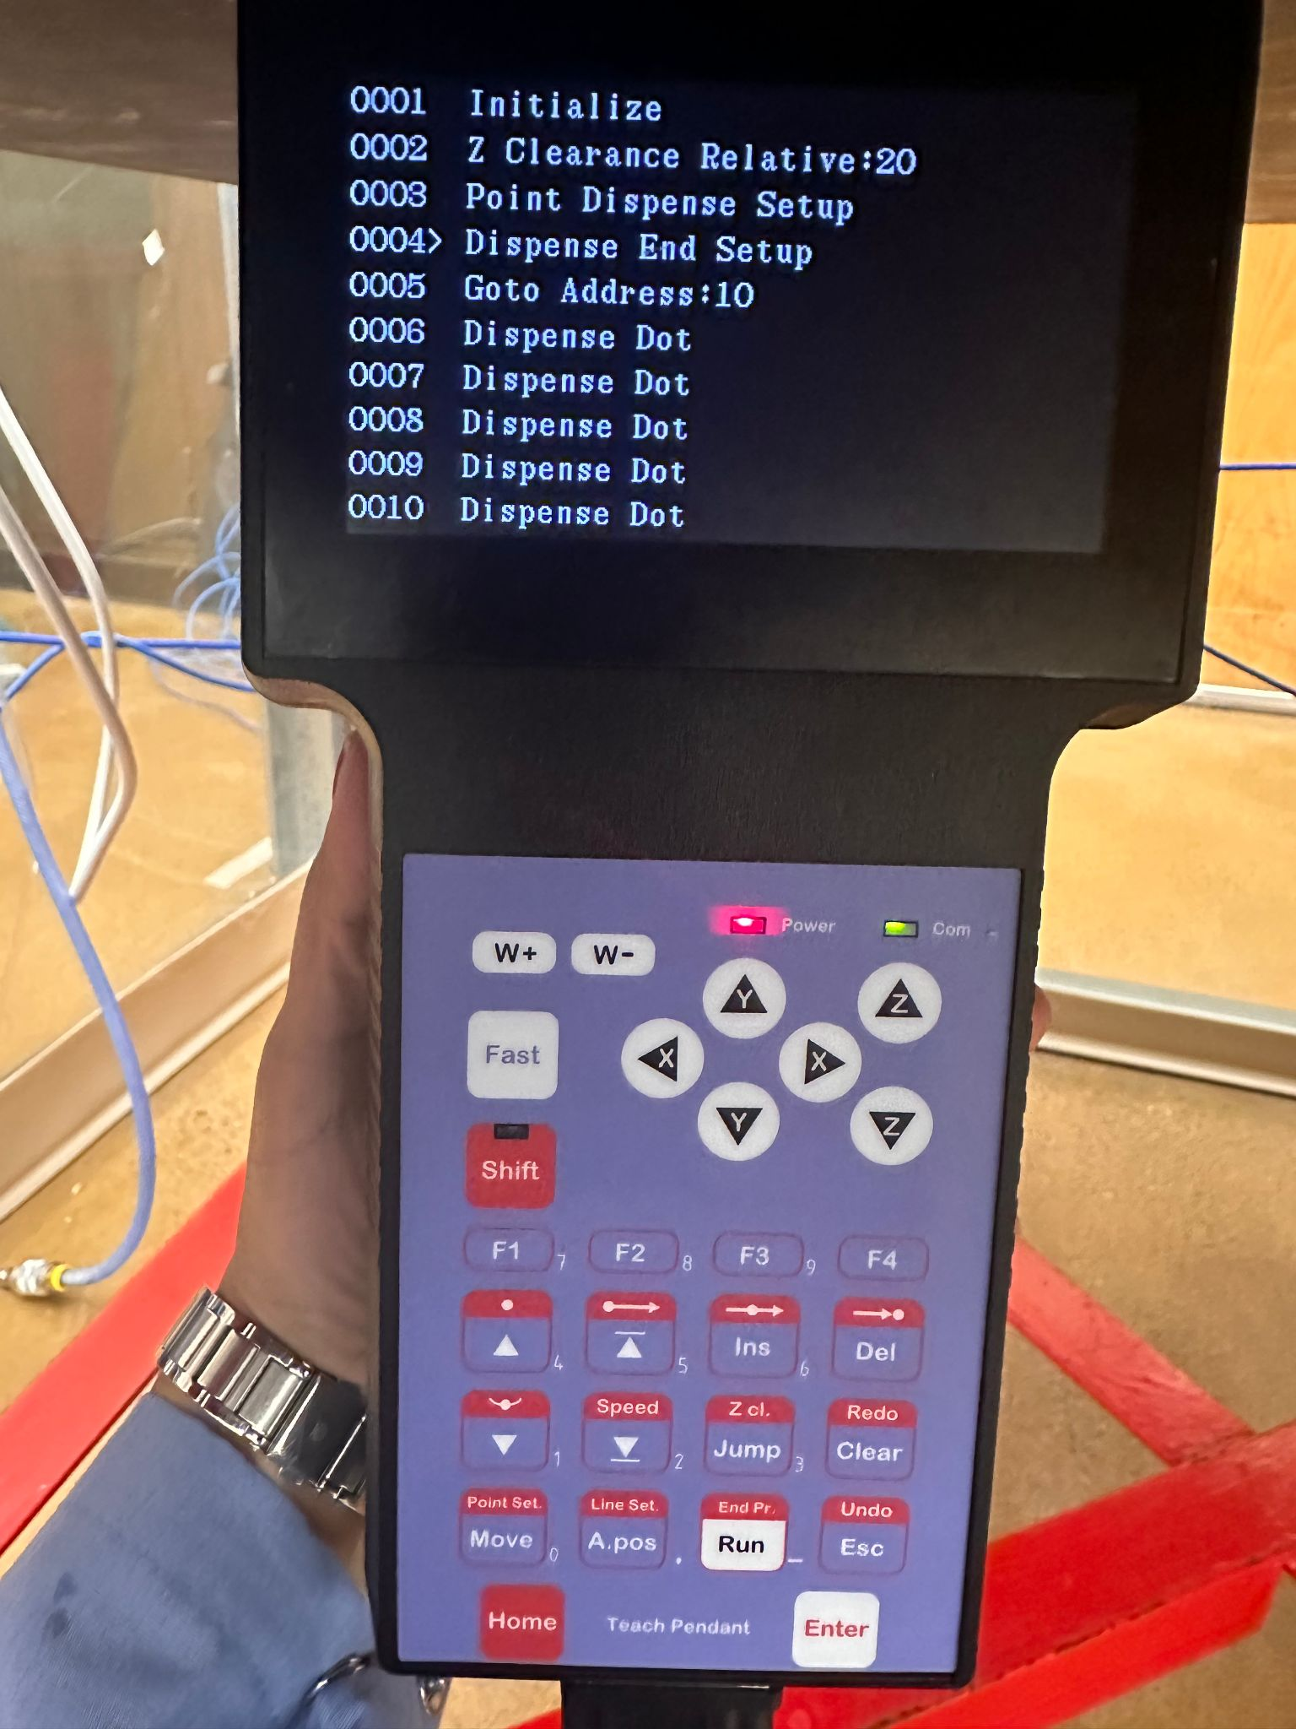
2 BASIC VIEWS
Esc button toggles between these two views
POINT LIST VIEW
POINT DETAILS VIEW

Slide 5
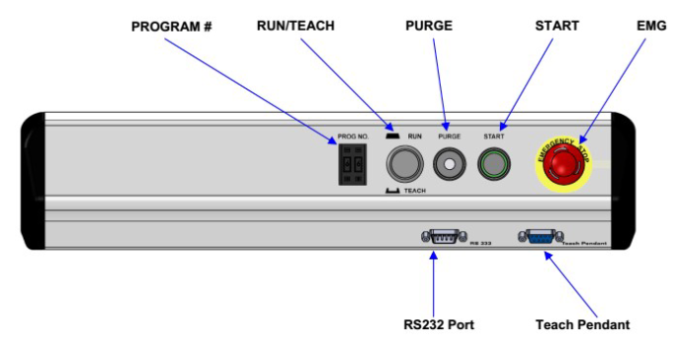
Program NO, NAME
Program List - F2 menu
Stores 99 programs

Slide 6
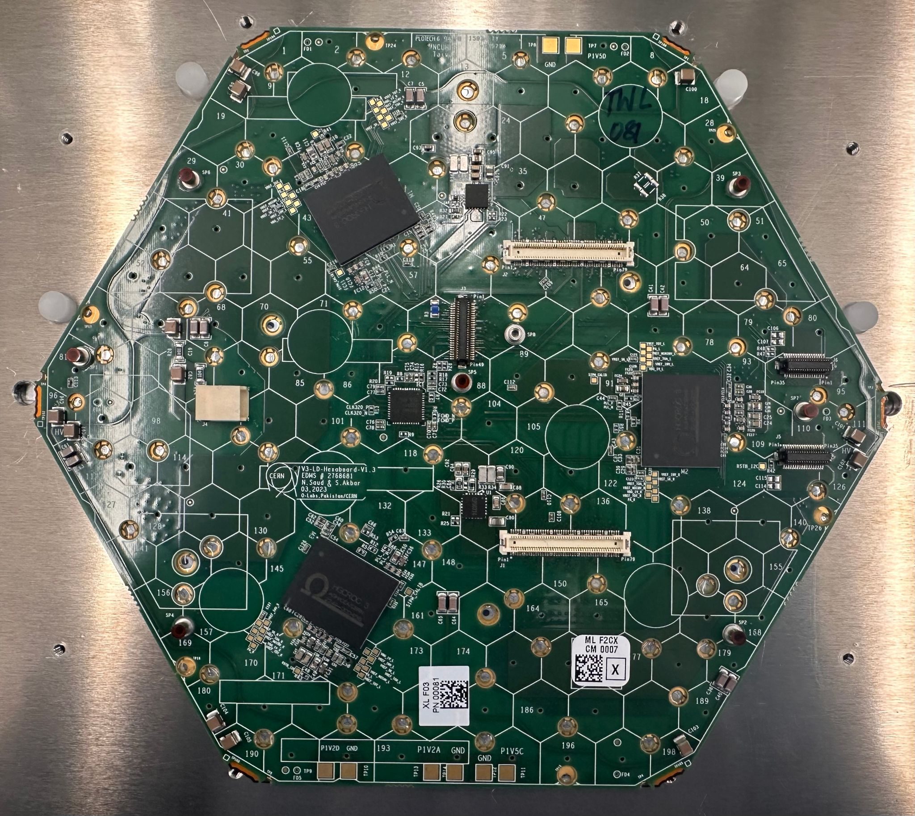
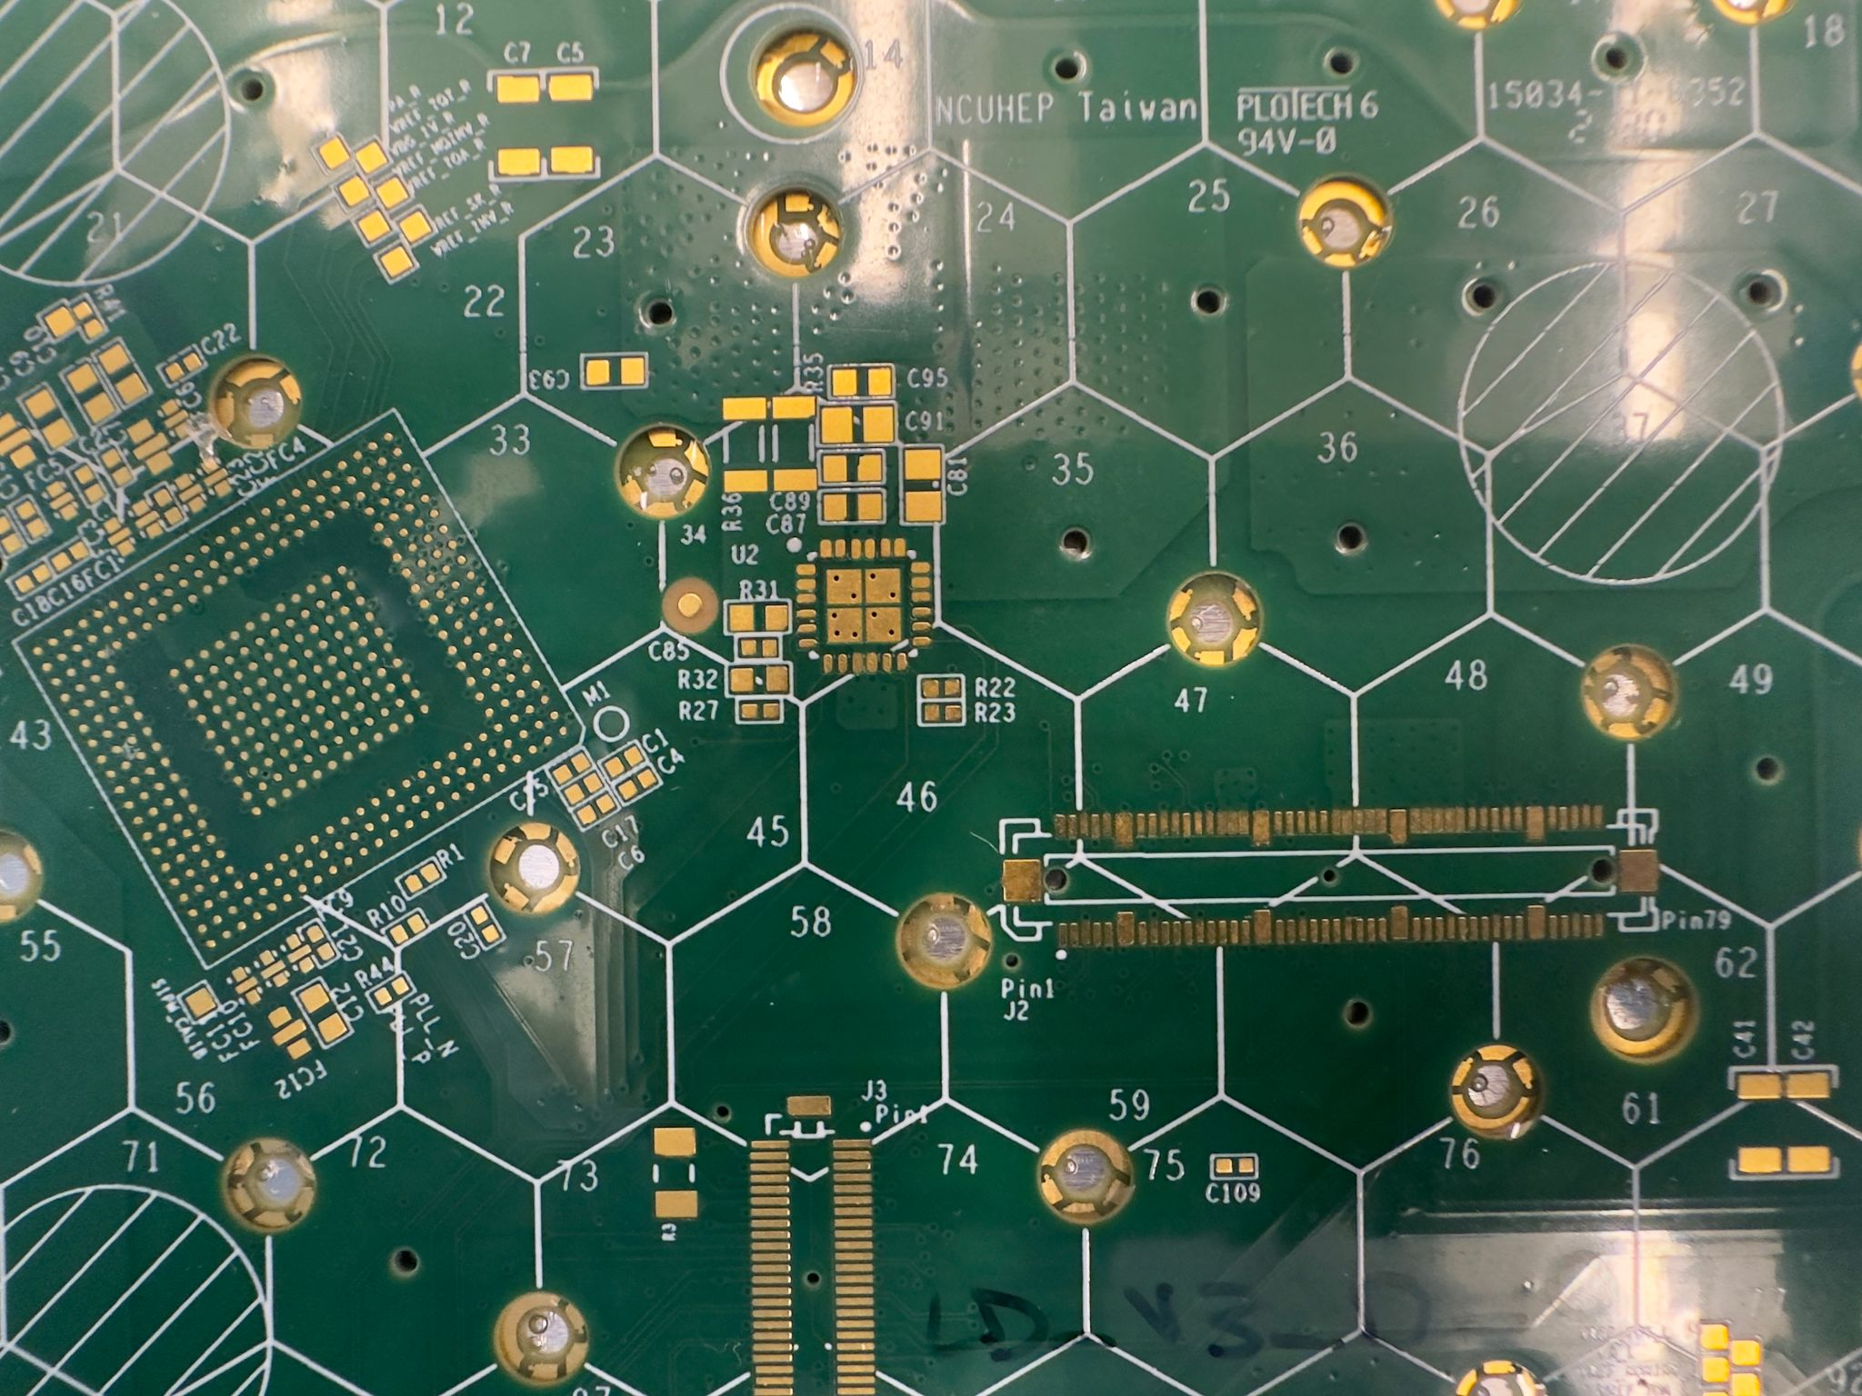
ENCAPSULATION SITES (3)
FRONTSIDE STEPPED HOLES

Slide 7
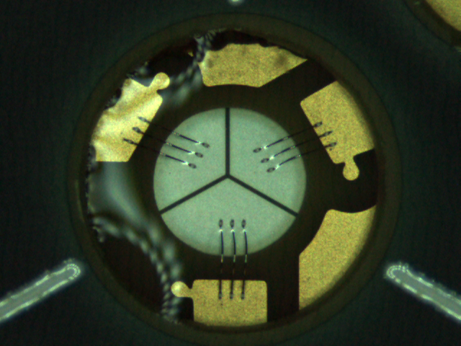

Slide 8

FRONTSIDE
STEPPED HOLES

Slide 9
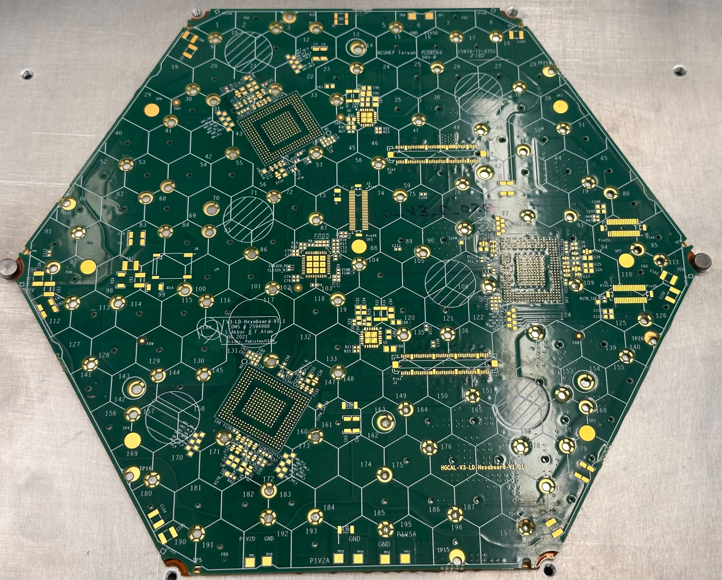
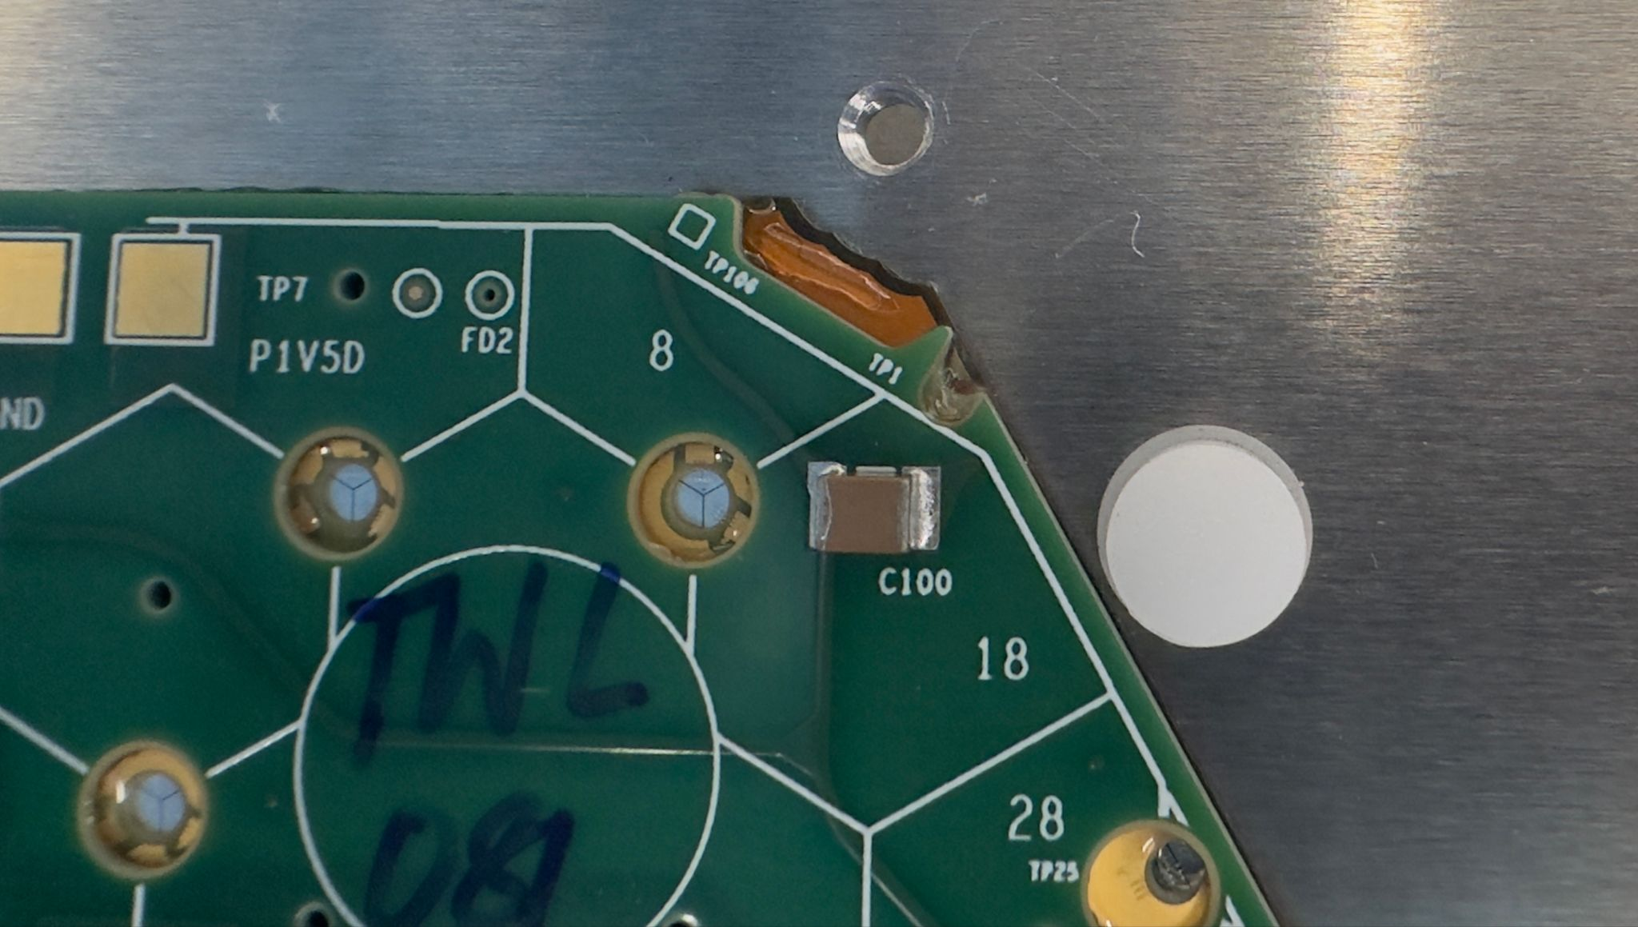
FRONTSIDE NOTCHES (6)
Notes:
Get good images from ogp COMPUTEr of notches.

Slide 10
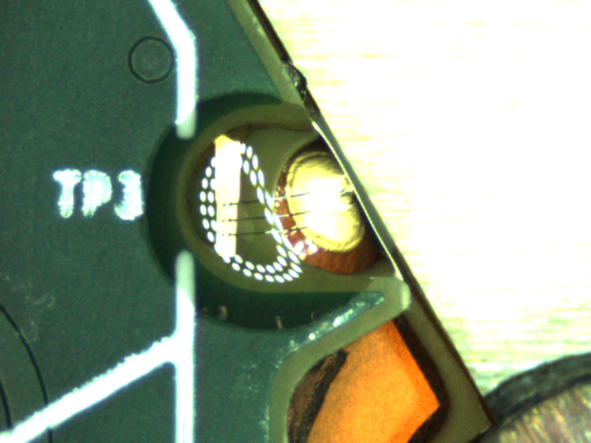

Slide 11
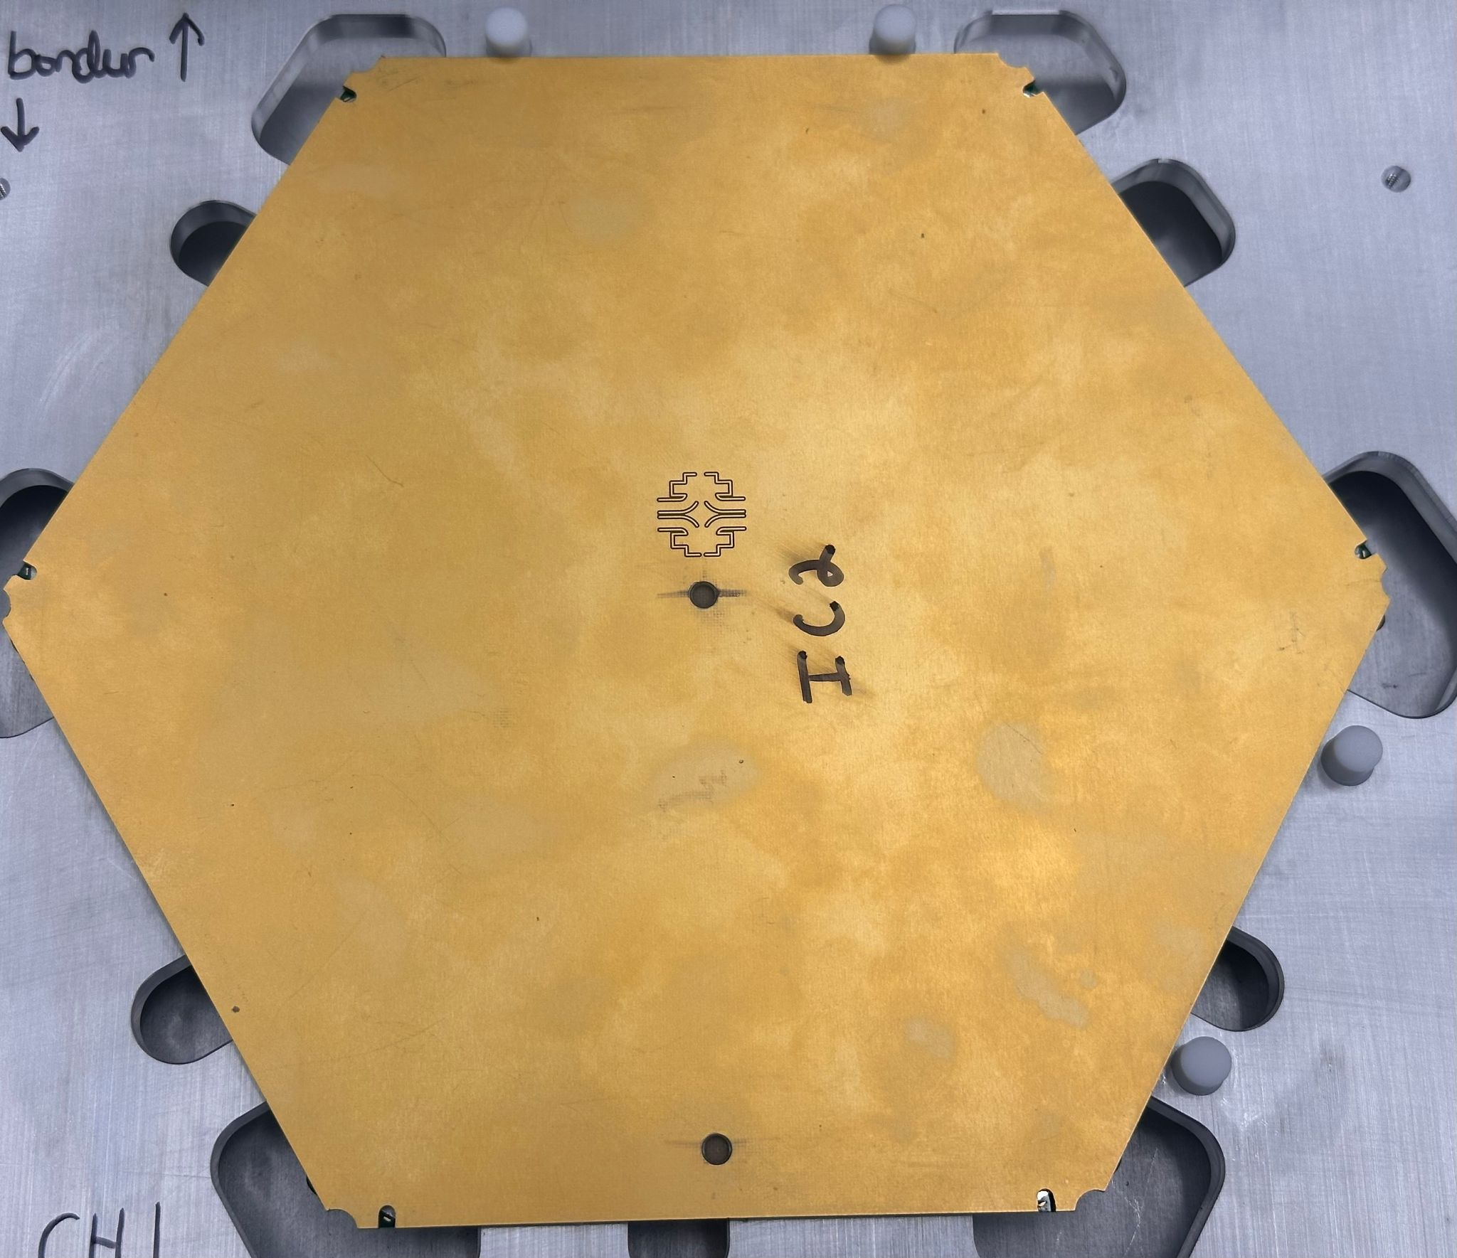
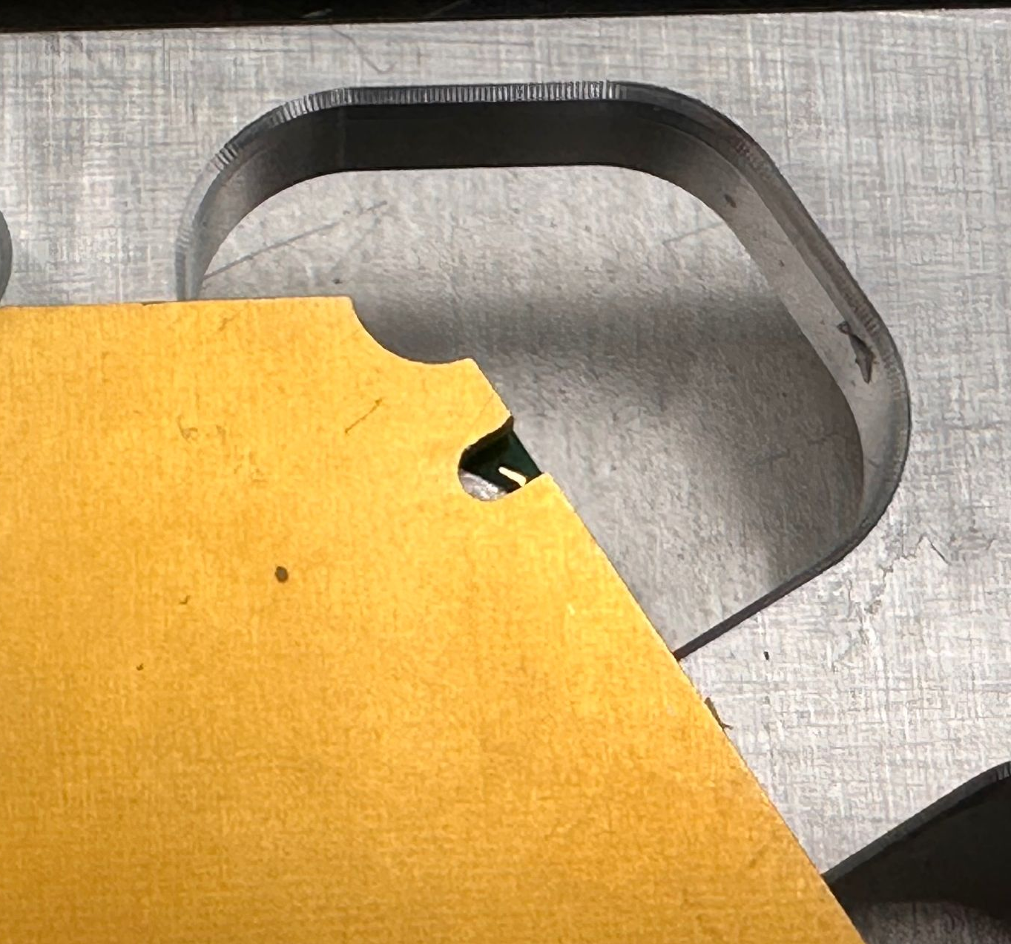
BACKSIDE NOTCHES (6)

Slide 12
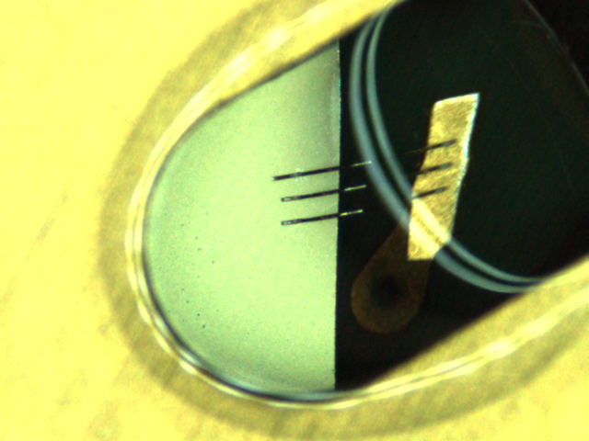

Slide 13
STATUS
4 PROGRAMS each for 200 μm and 300 μm , CF baseplate
Frontside stepped holes [FSH]
Frontside notches [FN] (6)
Backside notches [BN] (6)
Frontside [FS]
Inconsistent performance. Requires modifying the program any time a user tries to encapsulate a module , especially the notches
Notes:
Include images, by looking at the MA see the no of stepped holes

Slide 14
ENCAPSULATION OF NOTCHES
PROPER DISPENSE OF GLUE OVER THE NOTCHES IS HIT & A MISS
Narrow diameter of the notches makes them sensitive to the XY displacement. If the module's orientation differs from the program design orientation, the syringe tip may be misaligned
Risk of improper coverage.
redo encapsulation
Notes:
Include a picture,video showing the line is oriented in different directions., skeletal diagram with points and lines

Slide 15
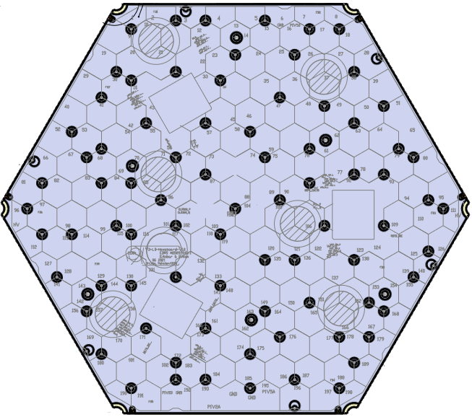
LD V3
GLUE PATTERN
LINE END
LINE START

Slide 16
Coordinate correction for 6 notches separately is time consuming ~ would require to compute displacement in XY every time new module is placed.
Correcting for (XY) offset using Group edit won’t work due to the glue pattern

Slide 17
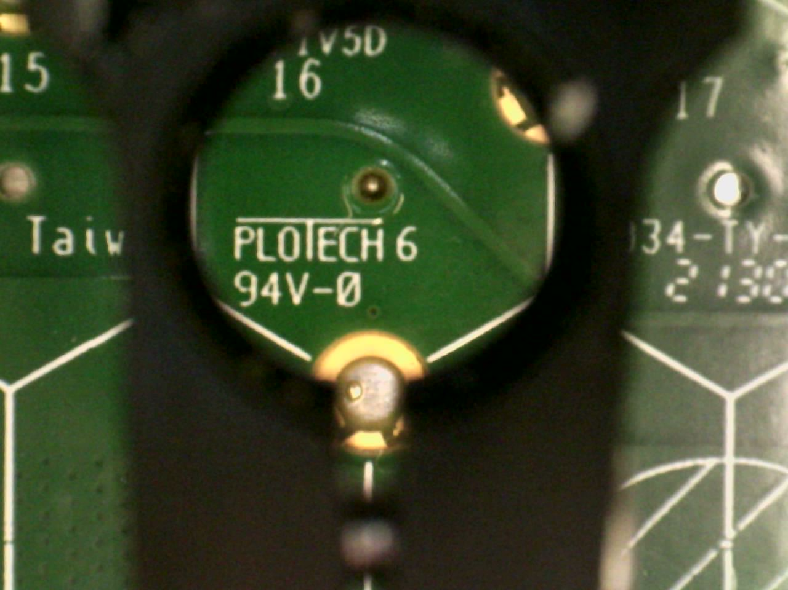
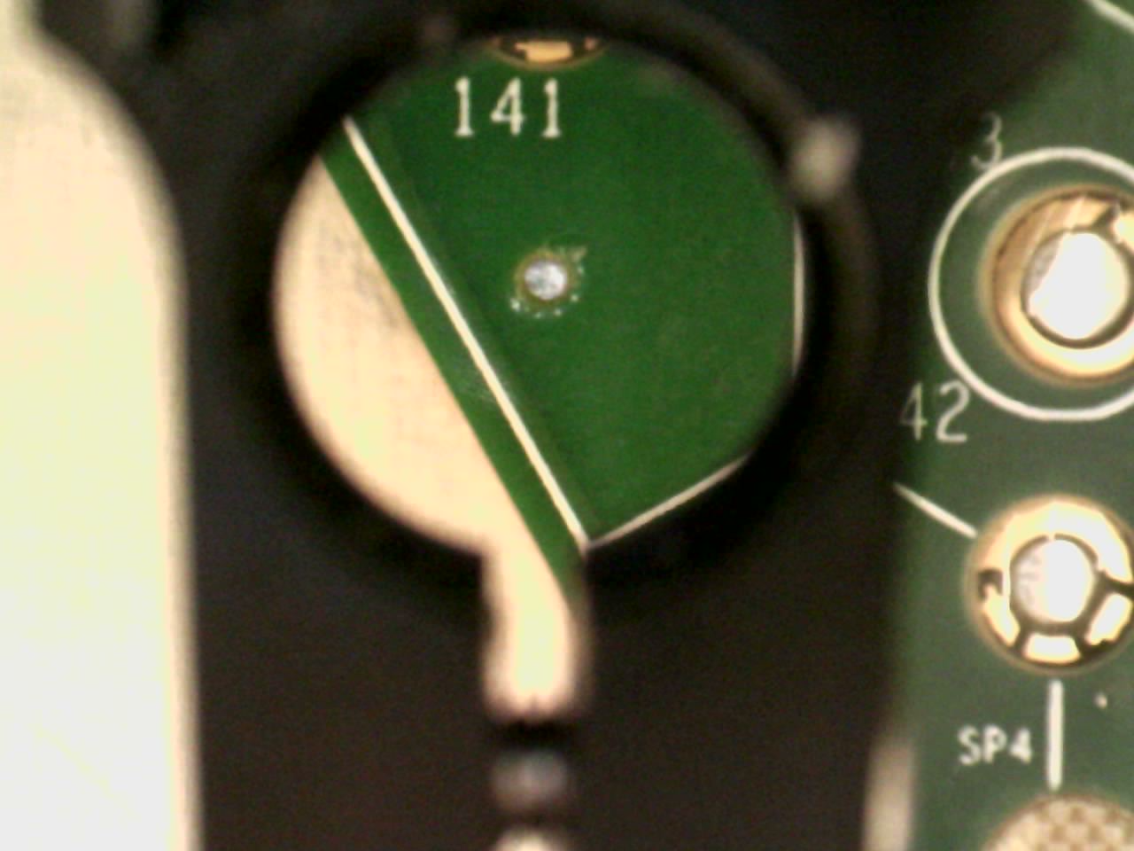
NEW SCHEME
Two reference points (R1,R2) on the hexaboard → account for offset.
R1
R2
Sharp point
Far apart

Slide 18
Tip goes to R1. Waits 4s.Tip goes to R2. Waits 4s
Tip aligned with R1, R2
Stop Program. Modify the R1, R2 coordinates using RELOCATE DATA
NO
Relocate data → allows the position of a program to be corrected, including rotation of the part in the work area
Atmost 2 coordinates as compared to 12 earlier
YES
Let the program continue

Slide 19

FRONTSIDE
NOTCHES

Slide 20
CONCERNS WITH NEW SCHEME
How reliable is visually estimating the alignment of the tip with the reference point?
Should we explore the option of using the camera to account for offset ?
Suggestions for reference points ?
Better ideas?
Notes:
Problems with the scheme

Slide 21
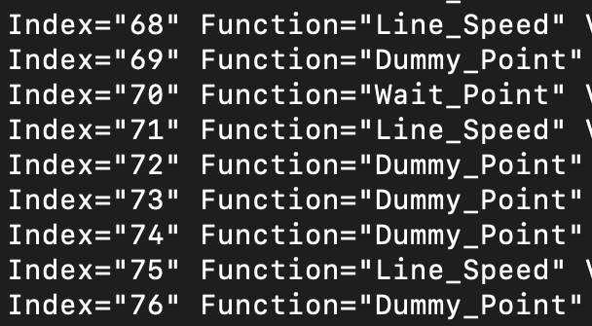
PROGRAM UPDTES
USCB program - 9 instructions to ensure proper deposition of the glue (6x)
Replaced with RETRACT SETUP
☰
RETRACT SETUP
Notes:
Image of xml file

Slide 22
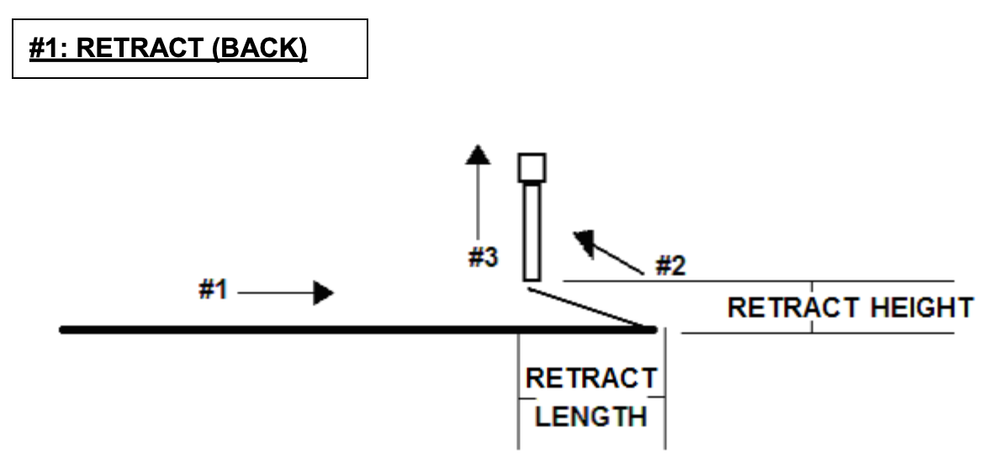
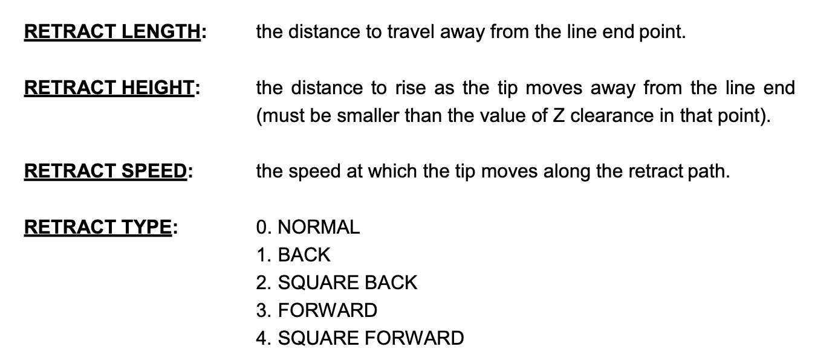
Must be inserted once - before the coordinates LINE START , LINE END

Slide 23
54 instructions replaced with 1 instruction
Finer control, less complex , no coordinates involved , reduces time → easier to modify if module specs change

Slide 24
PROGRAM NAMES
Conventions similar to the module names → key at the end = encapsulated site.
0 - delimiter → teach pendant only allows letters and numbers for naming
PROGRAMS starting with 2 → 200 μm
PROGRAMS starting with 3 → 300 μm
Test functions must have prefix TEST
Updated version of #20-23, #30-33 must have suffix v1,v2……..vN
#20 - 320MLF2CXCM0FSH
#21 - 320MLF2CXCM0FN
#22 - 320MLF2CXCM0BN
#23 - 320MLF2CXCM0FS
#30 - 320MLF3CXCM0FSH
#31 - 320MLF3CXCM0FN
#32 - 320MLF3CXCM0BN
#33 - 320MLF3CXCM0FS
# 90 - 98 BLOCK Reserved for TEST FUNCTIONS
Notes:
72 , 73 = 72 is the retract setup, 73 is the reference point and with the old dummy points

Slide 25
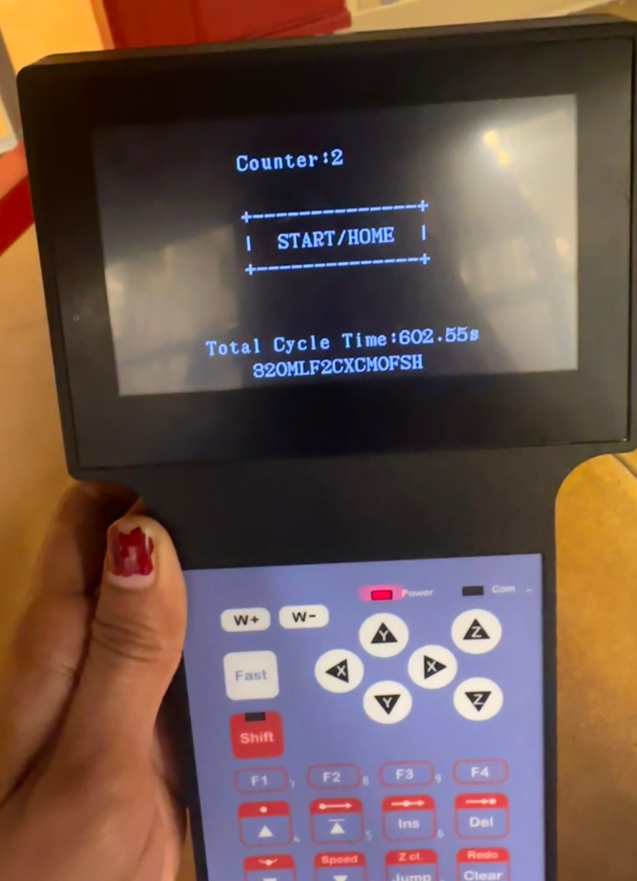
NAME displayed on the screen while the PROGRAM runs in RUN MODE

Slide 26
EDITING PROGRAMS
DO NOT EDIT #20-23 , #30-33.
If you wish to edit copy them to an empty slot using COPY option in Utility menu (F2) and then make changes to the copied version
All 8 programs (plus test functions)- currently in use password protected. Cannot edit without password.
Those with the password - a good practice to follow: lock the program to prevent inadvertently editing it
Deleted older programs that were not in use .

Slide 27
BACK-UP OPTIONS
MAIN UNIT | USB | GITHUB
Backup option in Utility → Program in F2 menu . Creates a backup of the current program in reserved backup location on the memory card. A separate backup location is reserved for each program number. Backed up data can be easily restored using the Restore option in Utility → Program in F2 menu . | All programs are backed up in the mini-gantry USB USB must have a dir `Programs` for proper upload/download | Programs are in .xml format. Once finalized , push to git repo ?
***Copy of all PROGRAMS written so far is on the test stand PC inside dir encap prgrms

Slide 28
GLUE LEAKAGE
Vacuum knob controls the suction.
1.5 turns Counter CW should prevent adhesive dripping.
If the glue still leaks, slightly increase the setting.
Perform this check each time you replace the syringe.
Avoid turning the vacuum too high and cause the generation of bubbles in the syringe. Air bubbles trapped in the syringe can be dispensed as a gap.
Notes:
Can the key beep if the tip touches surface.

Slide 29
INSUFFICIENT GLUE DISPENSED AT THE INITIAL POINT OF APPLICATION
First stepped hole/ notch receives less glue deposit → uncovered wire bonds
Insert a new Memory Address : DISPENSE ON before the first point of application.
Allows time for the material to flow to the tip
Notes:
Can the key beep if the tip touches surface.

Slide 30
OFFSET IN THE THICKNESS OF THE MODULES → LOWERING OF THE TIP ALONG Z-AXIS → DAMAGED BONDS
Max Z-axis limit set for each program (except FS )
Tip won’t lower beyond the max z-axis limit while editing the program
Notes:
Can the key beep if the tip touches surface.

Slide 31
PRESSURE SETTINGS INCREASED FROM 15 psi to 22 psi
Expired glue
Use upto 6 months from expiry.
Notes:
Can the key beep if the tip touches surface.

Slide 32
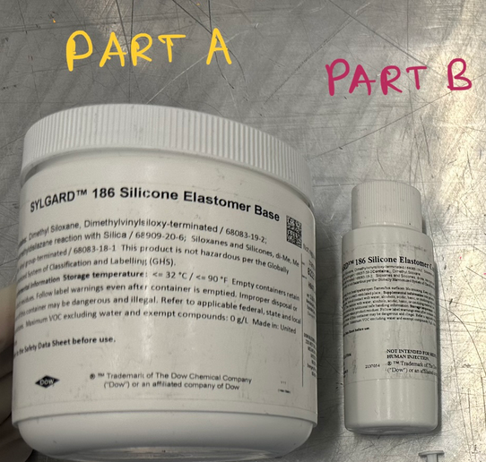
ESTIMATES
Sylgard (encapsulant) - Part A
Araldite (epoxy) - Part B
FRONTSIDE Glue = 5 ml of part A can encapsulate the frontside of 3 modules (FSH + FN)
BACKSIDE
Glue = ?
Time = ?
Glue will not cure for up to 2 hours after preparation
SITE | TIME (s) | TIME (min)
FSH | 602.55 | ~ 10
FN | 64.48 | ~ 1

Slide 33
DOCUMENTATION UPDATED
3 separate documents
1 - preparation of the glue and how to run the program
2 - program description (Use DEBUG PROGRAM option)
3 - Troubleshooting and for editing the programme
Anyone who makes any changes to the program MUST FILL THE LOGBOOK
Push to github ?

Slide 34
NEW SCHEME
Two reference points (R1,R2) on the hexaboard → account for offset.
R1
R2
Sharp point
Far apart

Slide 35
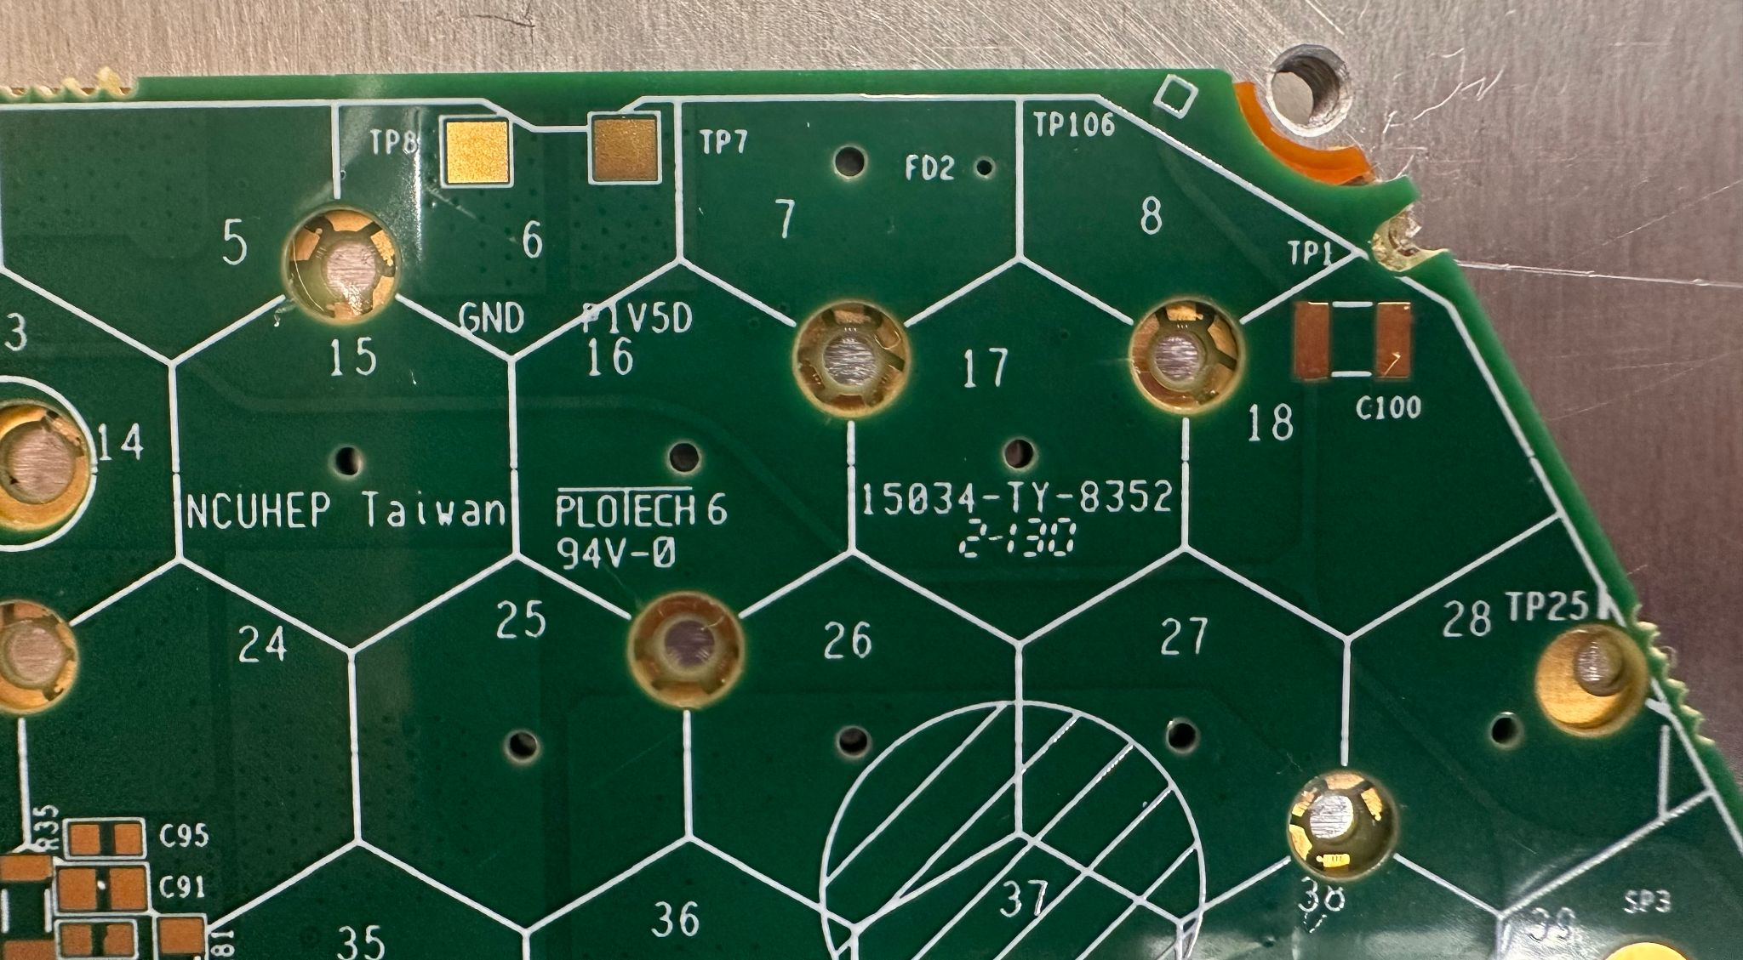
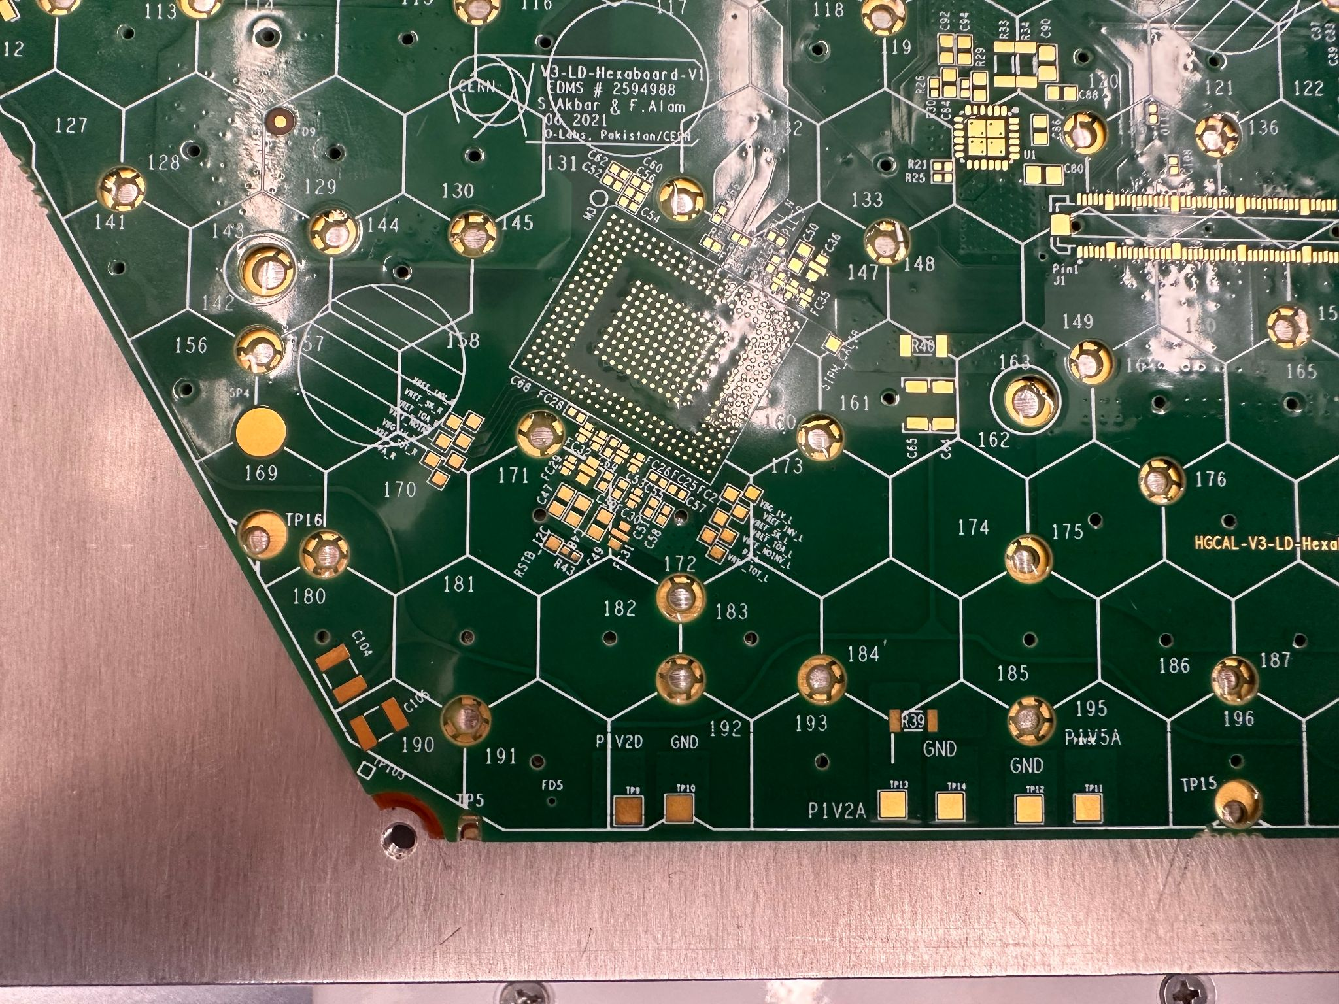
UPDATE
10/ 1 / 2024
R1, R2 for Frontside Notches updated - FD2, FD5

Slide 36
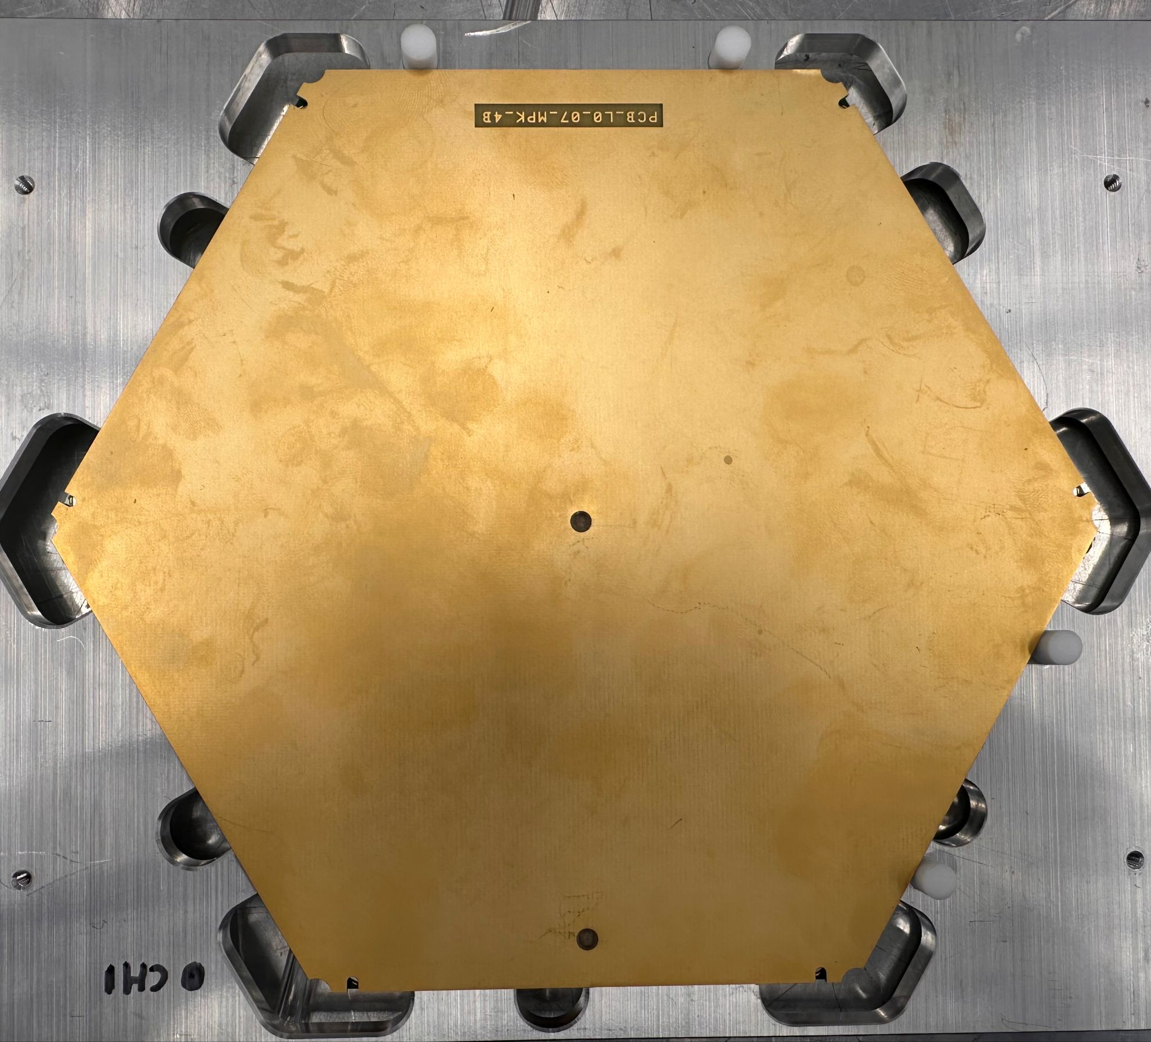
Scheme with 2 Reference points extended to Backside notches
R1
R2

Slide 37
Programs configured for 2 slots
Operating manual pushed to github

Slide 38
BACKUP

Slide 39
Correcting the coordinates for the XY offset using Group Edit isn’t feasible since the glue is dispensed as a line ,also z height is different scattered .
Coordinate correction for 6 notches separately is time consuming ~ would require to compute displacement in XY every time new module is placed.
Try dispensing it as a point - issue still persists !! If the module is displaced from the default location you still need to edit the coordinates (time required reduces as you only have 6 points). Can’t do GE as the notches are oriented in different directions. We presumed dispensing as dot would work as the glue will spread over , however if the glue isnt completely deposited inside the holes it will just stick to the BP. encapsulation isn’t clean as a line dispense.

